Slide 1


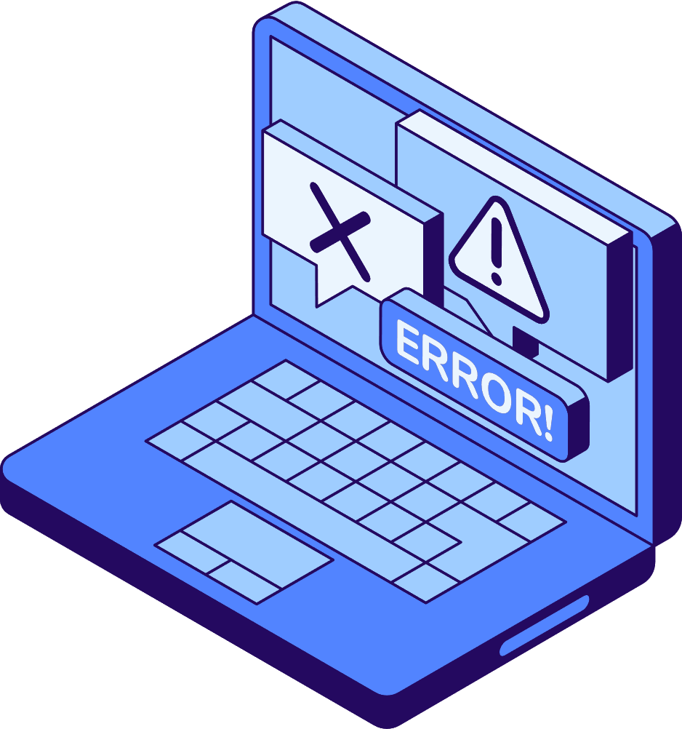




ST10451195_KYLE PILLAY
PROG6212
POE
MonthlyClaimsSystem

Slide 2
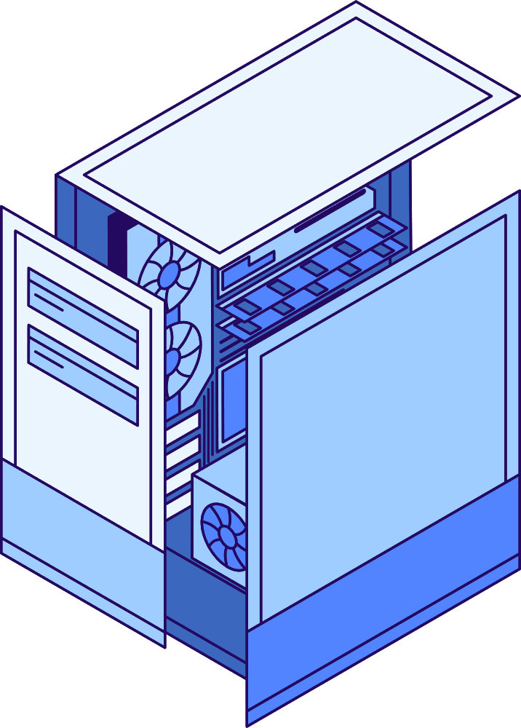

Liceria Tech
Overview Of The System
The Contract Monthly Claim Management System is an ASP.NET Core MVC web application that manages lecturer work claims using a secure login system with different user roles. Lecturers can submit claims, while Program Coordinators and HR users review, approve, or manage them through their own dashboards. All data, including users and claims, is stored in a local SQL Server (SSMS) database to ensure reliability and proper record-keeping.

Slide 3
Liceria Tech
ASP.NET Core MVC is used to build the web application structure, controllers, views, and business logic.
Entity Framework Core with SQL Server (SSMS) handles all database operations, including user accounts, roles, and claim records.
ASP.NET Core Identity provides secure authentication, role-based authorization, and user management for Lecturer, Program Coordinator, and HR roles.
Technology
Stack

Slide 4

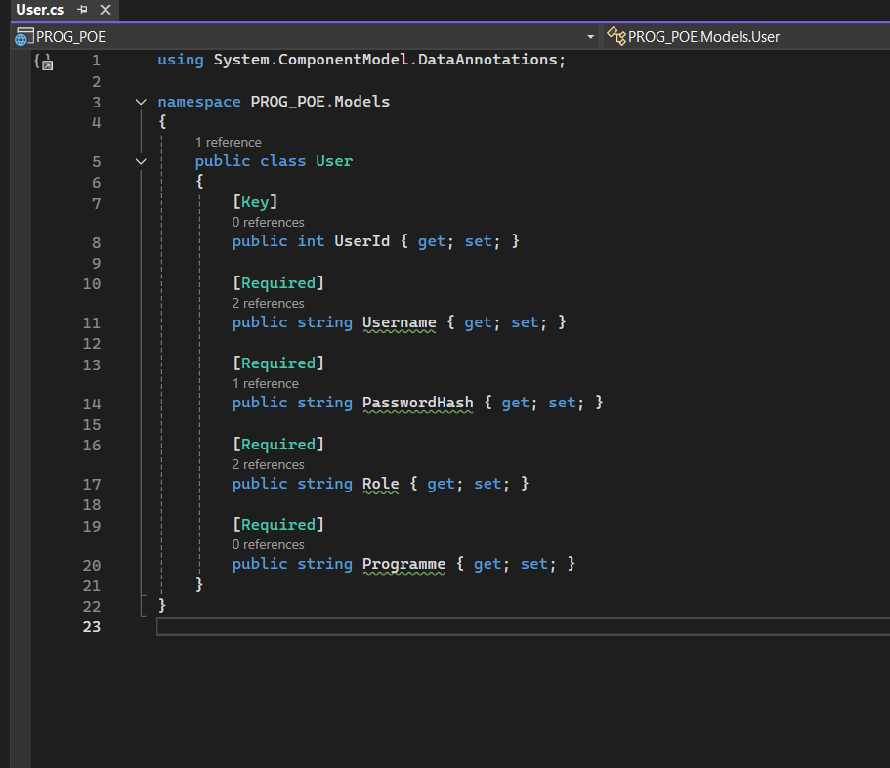
Liceria Tech
User Roles And
Access

Slide 5

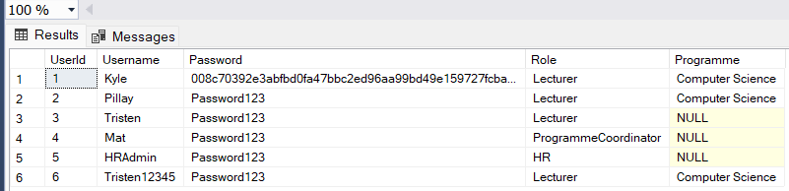
Liceria Tech
SQL Database

Slide 6
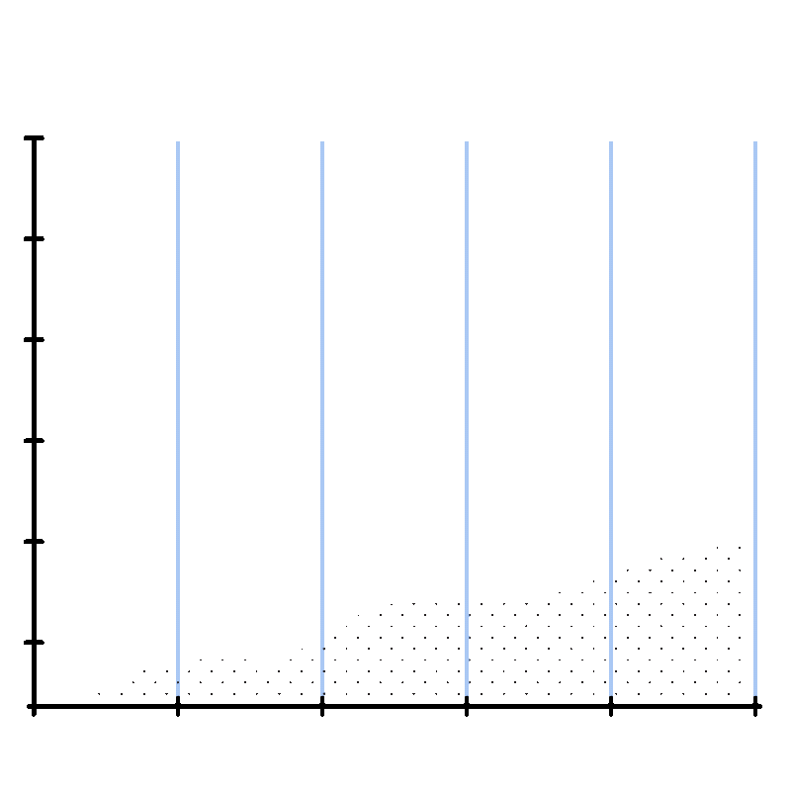
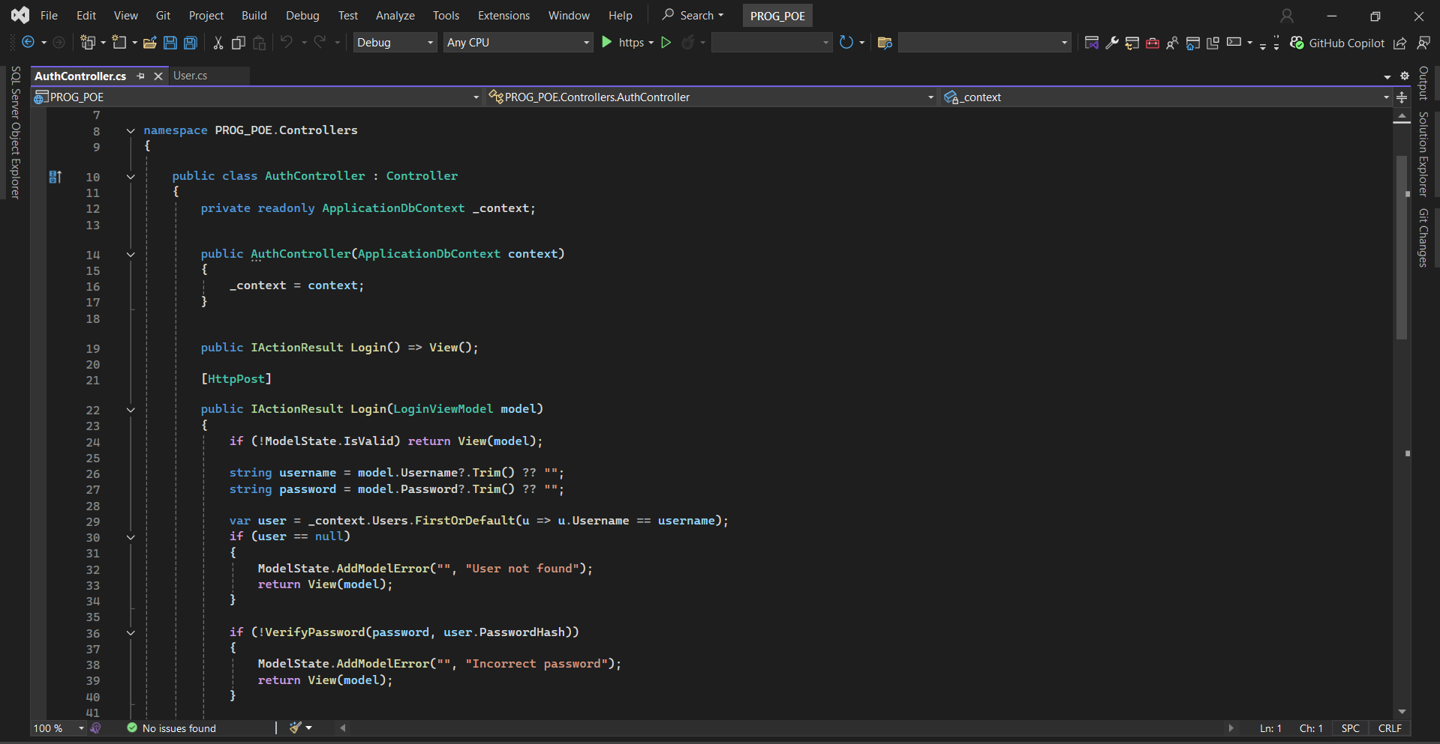
User
Liceria Tech
Authentication

Slide 7

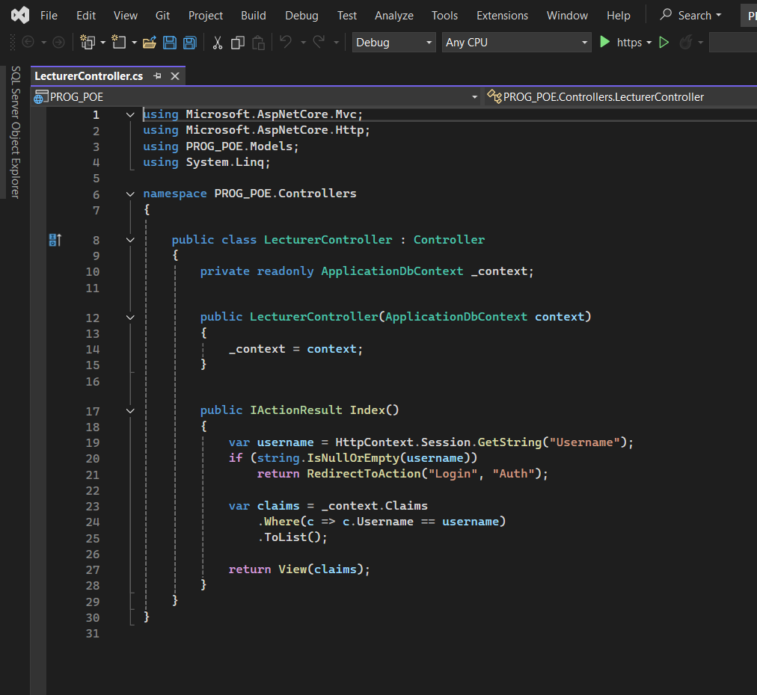
Liceria Tech
Lecturer Functionality

Slide 8
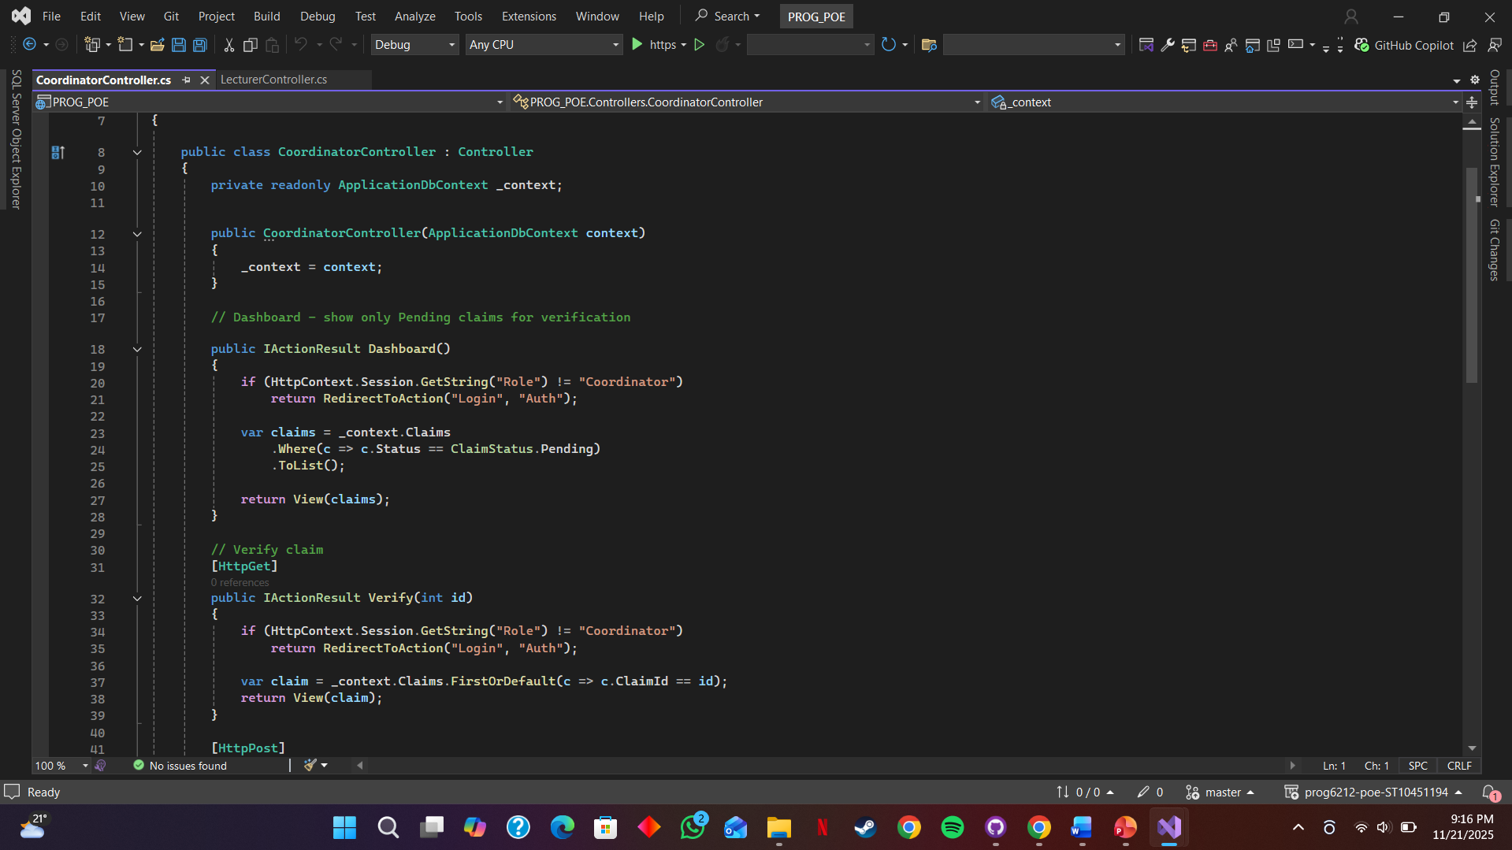

Liceria Tech
Co-ordinator
Functionality

Slide 9
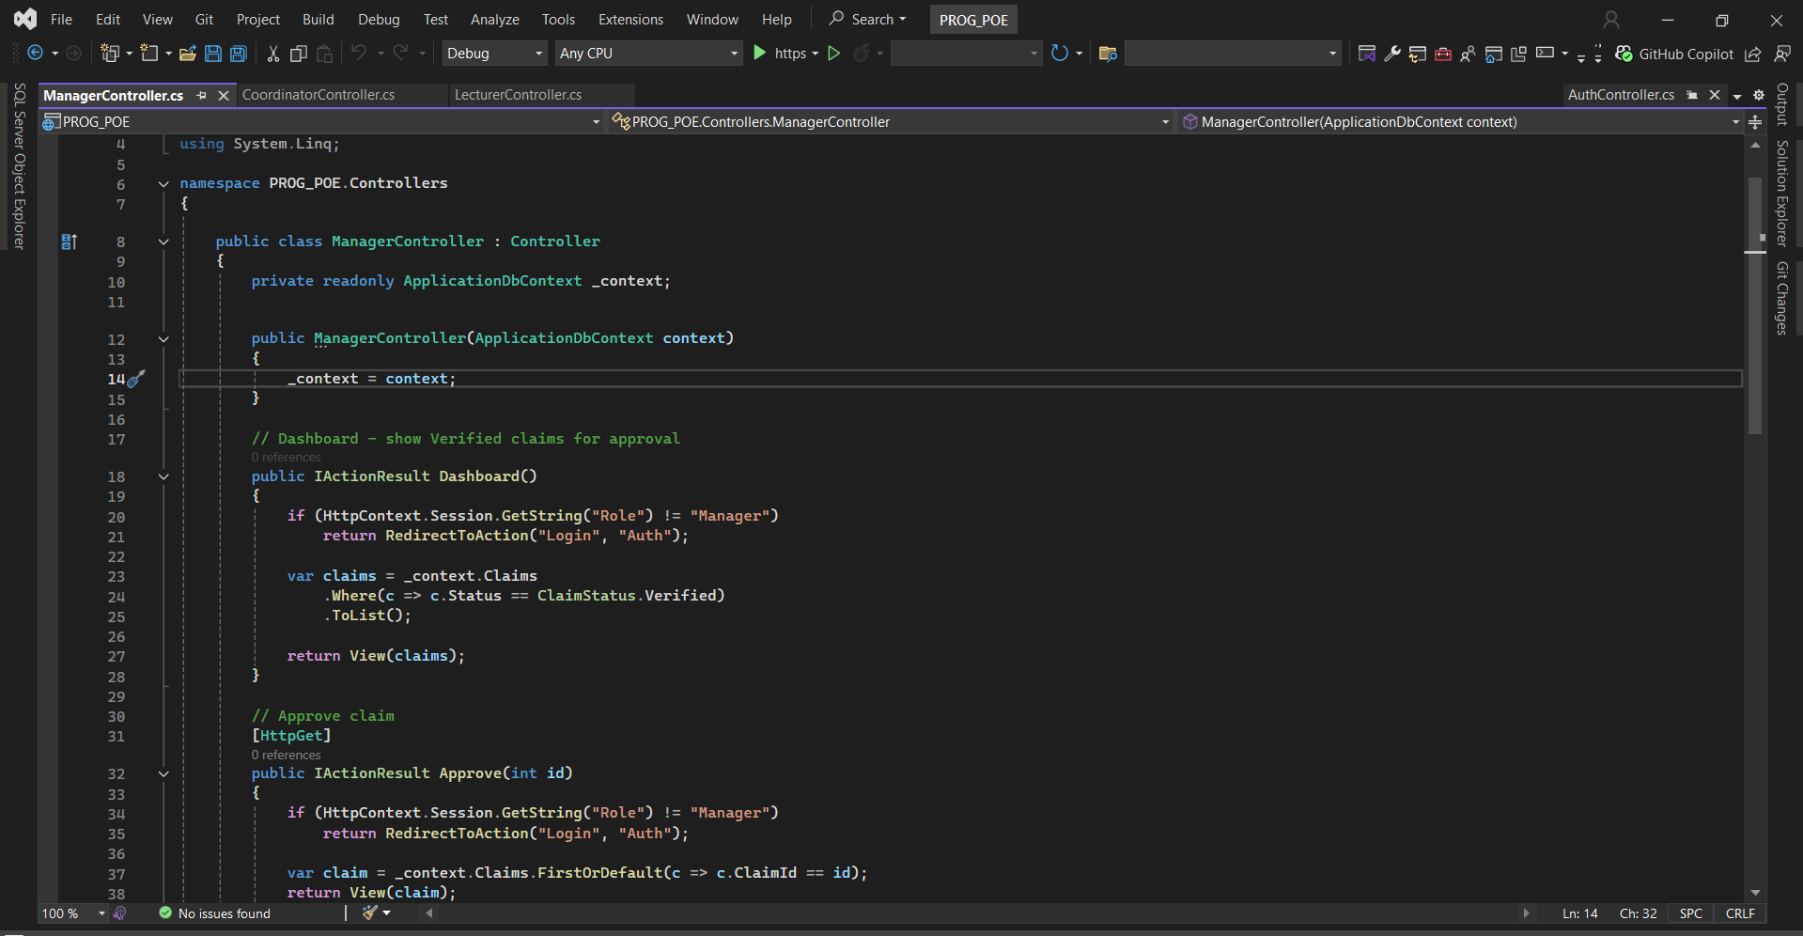
Liceria Tech
Manager Functionality

Slide 10
Liceria Tech
Important Code Components
The claims program is built using a structured approach where models define the data for users, claims, and claim files, ensuring consistency and organization. Controllers manage the application logic, handling actions like creating, updating, and exporting claims. Views provide a user interface that displays information and allows users to interact seamlessly with the system, making the overall application functional and user-friendly.

Slide 11
Liceria Tech
UI
Overview
The user interface of the claims program is designed to be clean and intuitive, allowing users to navigate easily between different sections. Users can log in according to their roles, view their claims, submit new claims, and upload supporting documents. Dashboards provide a clear overview of claim statuses, while forms and tables make data entry and review simple. Overall, the UI focuses on functionality and ease of use, ensuring that users can manage claims efficiently without confusion.

Slide 12
Liceria Tech
Development Insights
During the development of the claims program, key insights were gained about building a structured and maintainable application. Using the MVC pattern helped separate concerns, keeping models, views, and controllers organized and easier to manage. Implementing database relationships between users, claims, and claim files ensured data integrity and simplified data retrieval. Additionally, handling file uploads securely and implementing role-based dashboards highlighted the importance of both functionality and user experience. Overall, the development process emphasized planning, modular design, and testing to create a reliable and efficient system.

Slide 13
Liceria Tech
Conclusion
In conclusion, the claims program successfully demonstrates a structured and efficient system for managing user claims. By combining a well-designed database, organized MVC architecture, and a user-friendly interface, the application allows users to submit, track, and manage claims seamlessly. The development process highlighted the importance of modular design, data integrity, and secure file handling, resulting in a reliable tool that meets both functional and usability requirements. Overall, the program provides a practical solution for streamlining claim management.

Slide 14



THANK YOU!

